Slide 1
Playing Card Recognition
Logan Williams

Slide 2
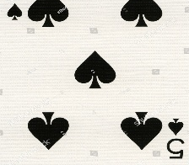
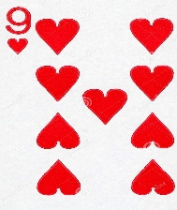
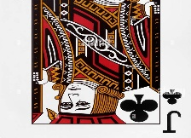
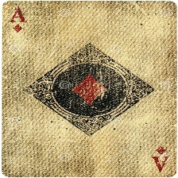
The Goal
Optimally identify playing cards
Prioritize partial results
Rank and Suit
Use for visually impaired, casinos, or private card game players

Slide 3
A Typical CNN
CONV
FC
CONV
CONV
FC
CONV
Input Image
FC
n
Output classes

Slide 4
A Typical CONV layer
CONV
Convolution
Batch Normalization
ReLU
Pool
In ch:
Out ch:
Kernel:
Stride:
Padding:

Slide 5
A Typical FC layer
Fully Connected (FC)
ReLU

Slide 6
Branching Models
FC
FC
FC
CONV
CONV
CONV
CONV
FC
FC

Slide 7
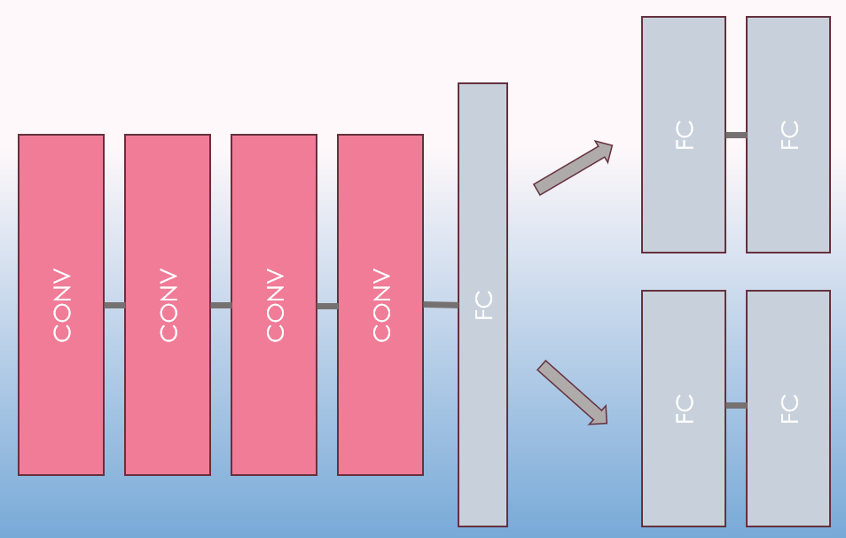
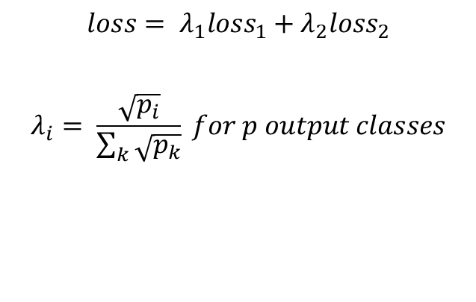
Backpropagation on branches
Processing Model
Class Model 1
$$loss= λ_{1}{loss}_{1}+λ_{2}{loss}_{2}$$
$$λ_{i}= \frac{\sqrt{p_{i}}}{\sum_{k}{\sqrt{p_{k}}}} for p output classes$$
Class Model 2

Slide 8


Implementation in PyTorch
$loss= λ_{1}{loss}_{1}+λ_{2}{loss}_{2}$
$λ_{i}= \frac{\sqrt{p_{i}}}{\sum_{k}{\sqrt{p_{k}}}} for p output classes$
Losses for each output are calculated from loss functions
Losses are combined
Can be generalized to M output labels

Slide 9
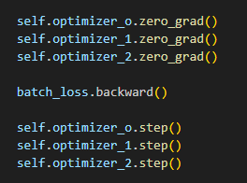
Implementation in PyTorch
Each sub-model requires its own descent algorithm
The gradient calculation backward() calculates for each optimizer
Then weights are updated with step()

Slide 10
Model 1
25% dropout
15% dropout
15% dropout
100 node
Leaky-ReLU
5 node output
Leaky-ReLU
500 node - Leaky-ReLU
CONV
3x3
Chnl:
60
Leaky-ReLU
Norm
2x2
Max-Pool
CONV
3x3
Chnl:
160
Leaky-ReLU
Norm
2x2
Max-Pool
CONV
3x3
Chnl:
320
Leaky-ReLU
Norm
2x2
Max-Pool
CONV
3x3
Chnl:
480
Leaky-ReLU
Norm
2x2
Max-Pool
25% dropout
100 node
Leaky-ReLU
14 node output
Leaky-ReLU

Slide 11
Model 2
25% dropout
15% dropout
15% dropout
15% dropout
500 node
Leaky-ReLU
100 node
Leaky-ReLU
5 node output
Leaky-ReLU
CONV
3x3
Chnl:
60
Leaky-ReLU
Norm
2x2
Max-Pool
CONV
3x3
Chnl:
160
Leaky-ReLU
Norm
2x2
Max-Pool
CONV
3x3
Chnl:
60
Leaky-ReLU
Norm
2x2
Max-Pool
CONV
3x3
Chnl:
320
Leaky-ReLU
Norm
2x2
Max-Pool
CONV
3x3
Chnl:
160
Leaky-ReLU
Norm
2x2
Max-Pool
CONV
3x3
Chnl:
480
Leaky-ReLU
Norm
2x2
Max-Pool
CONV
3x3
Chnl:
600
Leaky-ReLU
Norm
25% dropout
500 node
Leaky-ReLU
100 node
Leaky-ReLU
14 node output
Leaky-ReLU

Slide 12
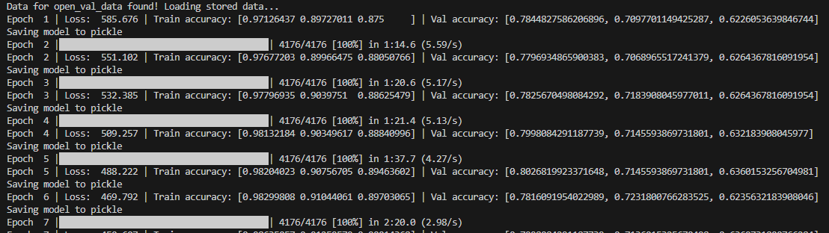
Training + Validation
Accuracy of (each model + combined) used
Save model at each epoch
Allow resume of training

Slide 13
Results
Hardware limitations affected testing limits
Model 1 performed better overall
High split between Suit/Rank accuracy
Model | Suit | Rank | Combined | 1+
Model 1 (full res) | 74.14% | 72.03% | 59.55% | 86.62%
Model 1 (low res) | 83.61% | 69.77% | 64.81% | 88.57%
Model 2 (low res) | 80.75% | 71.28% | 63.76% | 88.27%

Slide 14
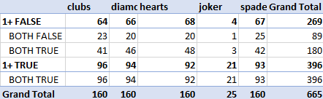
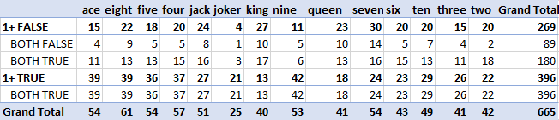
Results
Results broken down by class
Some models overperformed on Joker cards
Some underperformed

Slide 15
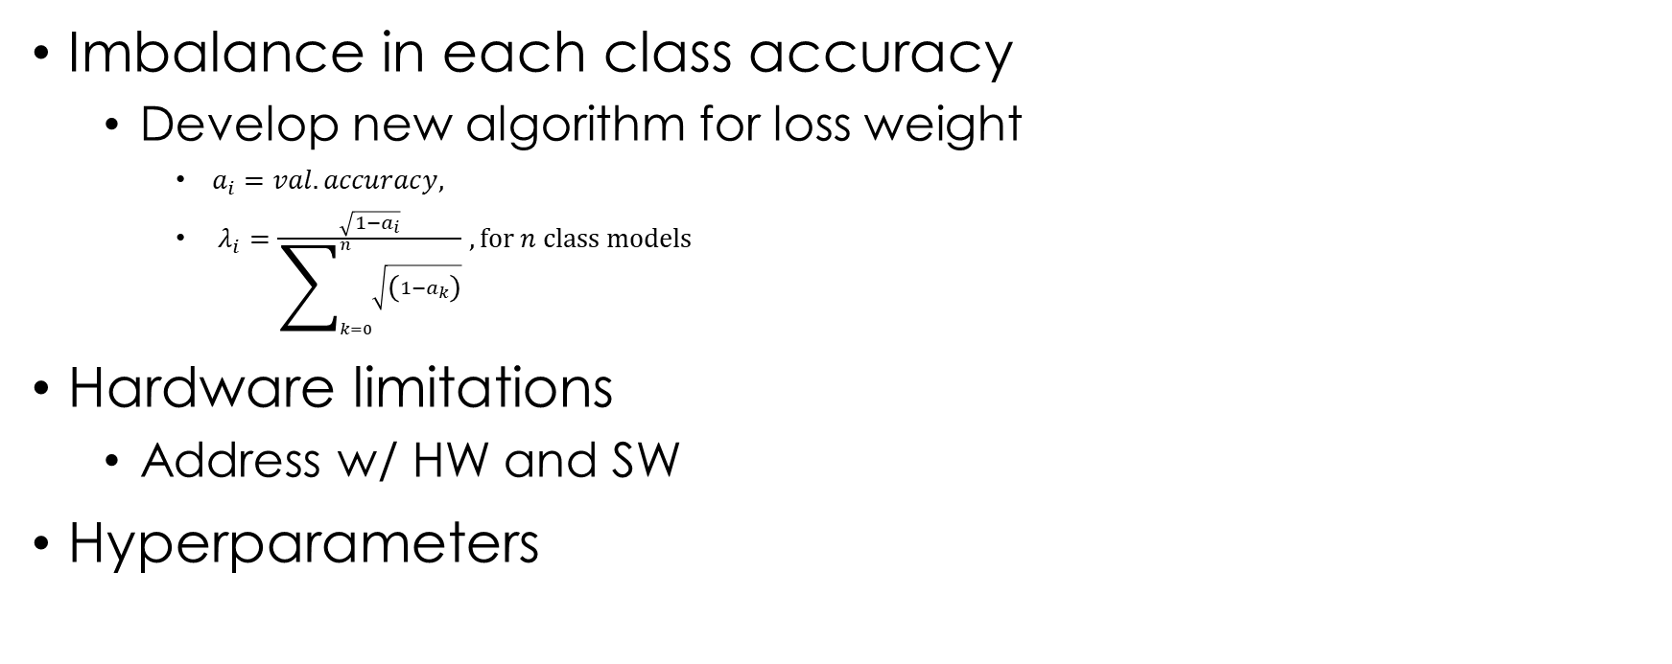
Future Work
Imbalance in each class accuracy
Develop new algorithm for loss weight
$a_{i}=val. accuracy,$
$λ_{i}=\frac{\sqrt{1−a_{i}}}{\sum_{k=0}^{n}{\sqrt{\left(1−a_{k}\right)}}}, for n class models$
Hardware limitations
Address w/ HW and SW
Hyperparameters

Slide 16
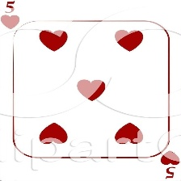
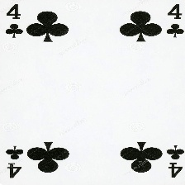



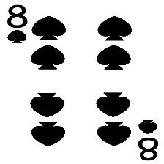
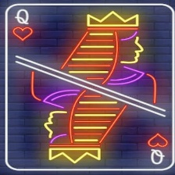
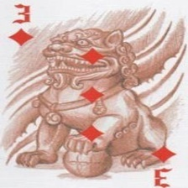
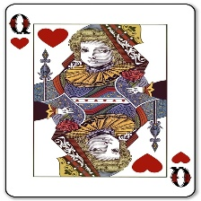
Conclusion
Branching models was successful
Proof of concept for dataset
Specific model/training not sufficient
Design parameters developed

